Slide 1
An overview
Probably sleeping
Francesco Logozzo (MSR Redmond)
Mehdi Bouaziz & Xavier Rival (ENS)
Ex-intern
(x3)
Visitor in Summer 2012

Slide 2
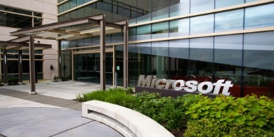
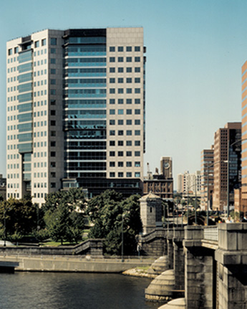
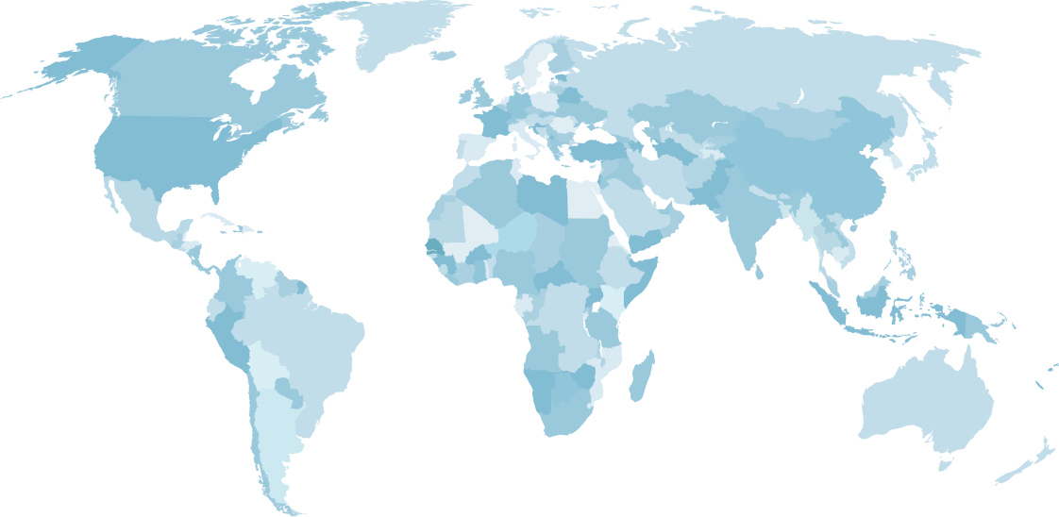


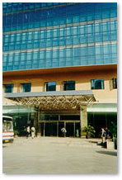

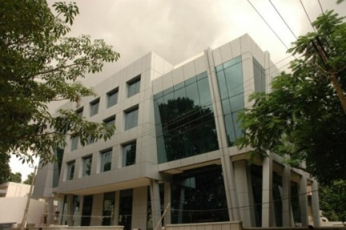
Microsoft Research
Worldwide Presence
Redmond, 1991
New England, 2008
Cambridge
Redmond
New England
Asia
ATLE
ATLI
Silicon Valley
New York
ATLC
India
Cambridge, UK
1997
Silicon Valley, 2001
ATLB
900 PhD researchers
Only 1% of entire Microsoft’s employee base, but by far the largest Computer Science research organization in the world
New York, 2012
Beijing, 1998
India, 2005
Notes:
Added MSR New York and asked Kevin for updated numbers for 2011/2012 but haven’t received response yet.

Slide 3
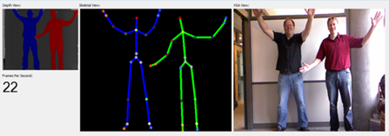
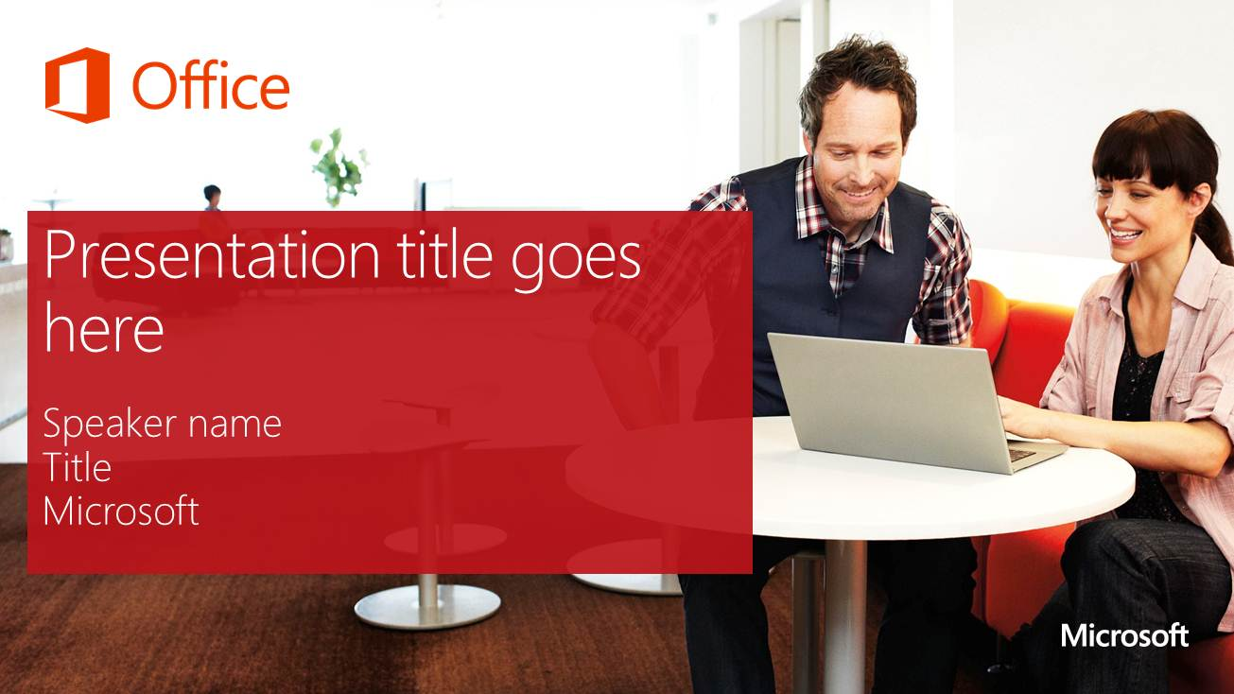
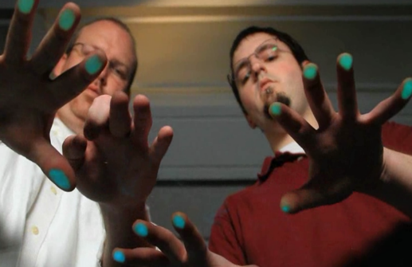


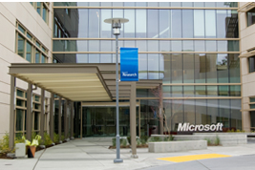
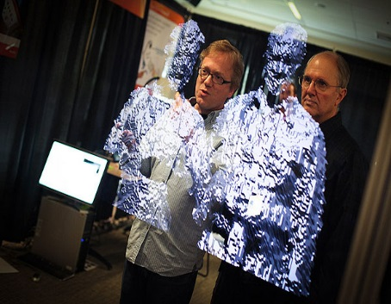
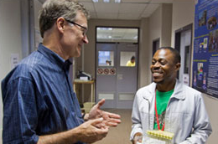

Microsoft Research’s mission
Expand the state of the art
Rapidly transfer technologies into products
Ensure that our tools have a future
More than 850 Ph.D. researchers in 13 research labs around the world push the boundaries in 55 areas of computing.

Slide 4

Microsoft Research does Basic Research
Basic research is carried out to increase understanding of fundamental principles.
Many times the end results have no direct or immediate commercial benefits.
However, it is the basis for many commercial products and applied research.
Nathan Myhrvold proposed and founded MSR in 1990
We were not the kind of company you would expect to do basic research
Microsoft in 1990:
$1B in sales
5000 employees
Key products:
Word, Excel, PowerPoint
DOS, Windows 3.0

Slide 5


























Automotive
Nearly every product Microsoft ships includes technology from Microsoft Research.
Notes:
MSR is a unique Asset
Research impacts almost every Microsoft product, service
Collaboration between research and product development is part of our DNA
A string of hits that have origins in research:
Kinect
Windows Phone
Bing

Slide 6
Some projects in RiSE

Slide 7
Automatic verification of an OS Kernel
Small Operating System + Applications (C#)
Typed Assembly Language
Verify
safety
with TAL
checker
Kernel/Apps
Bartok
Verify
safety &
correctness
with
Boogie/Z3
Verified Garbage Collector
Verified Threads
Verified Interrupt
Handlers
Verified Device
Interface
Verified
Startup
Nucleus
Boot Loader
x86 Hardware

Slide 8
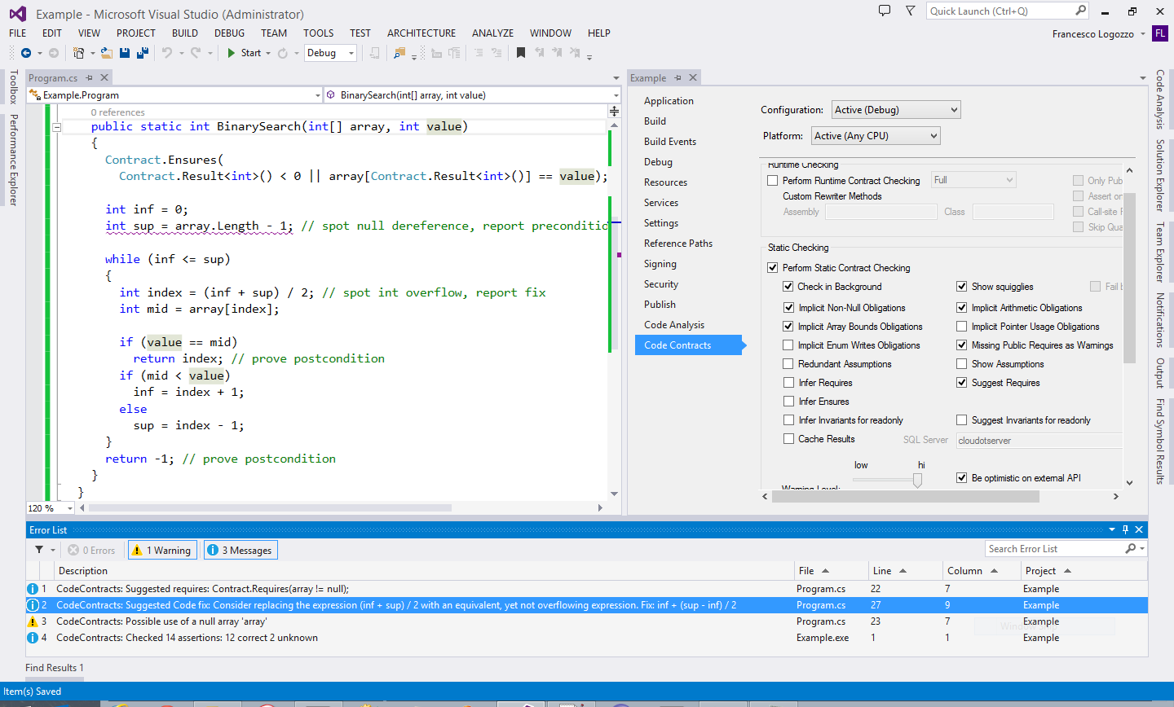
CodeContracts
Abstract interpretation for the working programmer
Ask Mehdi!!!!
(more to come)

Slide 9
F*

Slide 10
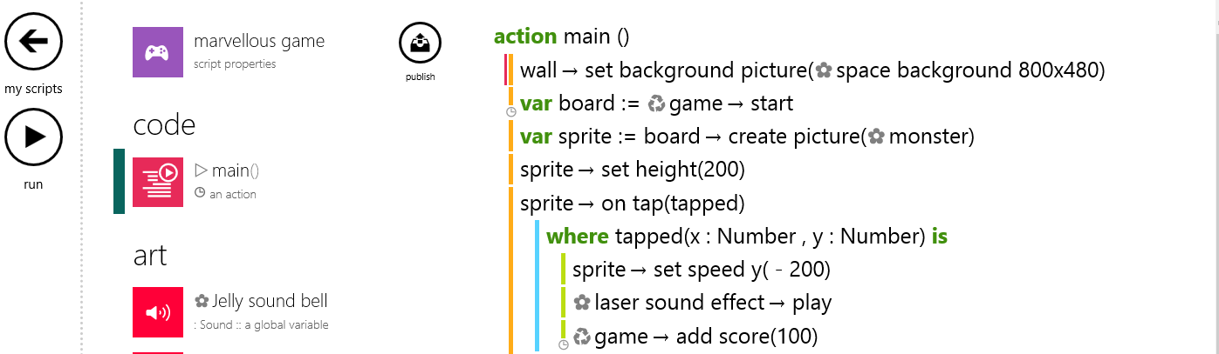
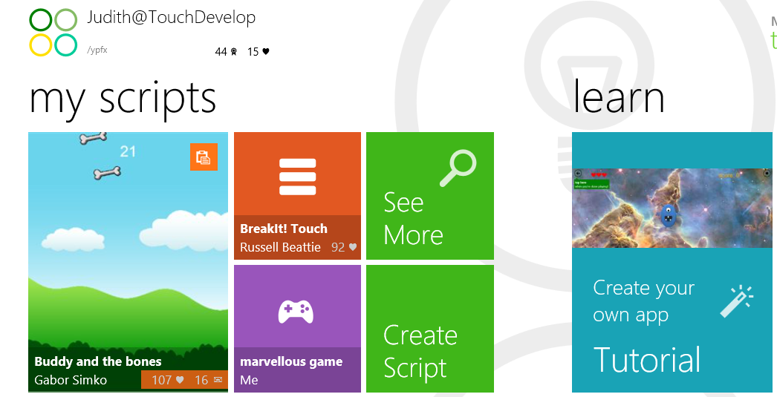
TouchDevelop https://www.touchdevelop.com/
TouchDevelop lets you create apps on iPad, iPhone, Android, PC, Mac, Windows Phone.
Our touch-friendly editor makes coding fun, even on your phone or tablet!

Slide 11
Z3 (http://z3.codeplex.com/)
High performance theorem prover
Integrates several decision procedures
Used in many, many tools
Program verification, termination, unit testing, test case generation, business applications modelling, security protocols, cryptography …
Arithmetic
Array Theory
Uninterpreted Functions

Slide 12
CodeContracts

Slide 13
Contracts in a nutshell
Preconditions
What my I expect from the callers
Postconditions
What I ensure to my callers
Object invariants
What holds in the steady state of the object
Preconditions and postconditions are automatically inherited
E.g., “.ToString()” returns a non-null string

Slide 14
CodeContracts
Idea: Use code to specify code
Why? No need for new compiler, language, etc.
Tools
Automatic documentation
Runtime Checking
Static checking
Fully abstract interpretation based!!!

Slide 15

Static verification with Clousot
Code Contracts Static checker
Source Code
.cs
VS/Roslyn
Semantic
Inference
with abstract interpretation
Error Checking
Verified repairs
Pre/Post inference
Assemblies
.dll/.exe
Warning prioritization
VS/Roslyn
Semantic baseline
By Mehdi & Jacques-henri
Stored Information

Slide 16
Which Abstract domain?
Many, many…
Analyze IL
So abstract domains to recover info lost in compilation
C#/VB have an heap
So abstract domains to do heap analysis and put program in scalar form
Programs manipulate values
So numerical abstract domains, non-null, strings, array values etc.

Slide 17
Example: Abstract domain for arrays
Challenge 1:
Effective handling of disjunction
public void Init(int N)
{
Contract.Requires(N > 0);
int[] a = new int[N];
int i = 0;
while (i < N)
{
a[i] = 222;
i = i + 1;
}
Contract.Assert(∀ k ∈ [0, N). a[k] == 222);
}
If i == 0 then
a not initialized
else if i > 0
a[0] == … a[i] == 222
else
impossible
Challenge 2:
No overapproximation (can be unsound)
(no hole, all the elements are initialized)

Slide 18
Elements of the abstract domain
Segment bounds
Disjunction
Uniform content abstraction
0
[222, 222]
i, k
?
[0, 0]
N
0 ≤ i, 0 ≤ k
i == k
i < N, k < N

Slide 19
Contract.Requires(N > 0);
int[] a = new int[N];
0
0
N
int i = 0;
0,i
0
N
0
222
1,i
0
N
?
assume i ≥ N
assume i < N
i -> _
j -> i
N -> N
0,i
0
N
a[i] = 222;
0,i
222
1,i+1
0
N
?
j = i+1;
0,i
222
1,i+1,j
0
N
?

Slide 20
Segment unification
0,i
0
N
0
222
1,i
0
N
?
0
⊥
i
?
0
N
0
222
1,i
0
N
?
0
⊥
i
?
0
N
0
222
i
0
N
?
Join
Can be empty segments! (Disjunction)
0
222
i
?
0
N
?

Slide 21
Contract.Requires(N > 0);
int[] a = new int[N];
int i = 0;
0
222
i
?
0
N
?
Remove doubts
(i == N && N > 0)
assume i ≥ N
assume i < N
0
222
i
?
0
N
0
222
i, N
a[i] = 222;
i -> _
j -> i
N -> N
And so on up to a fixpoint …
We visited all the elements in [0, N)
j = i+1;

Slide 22
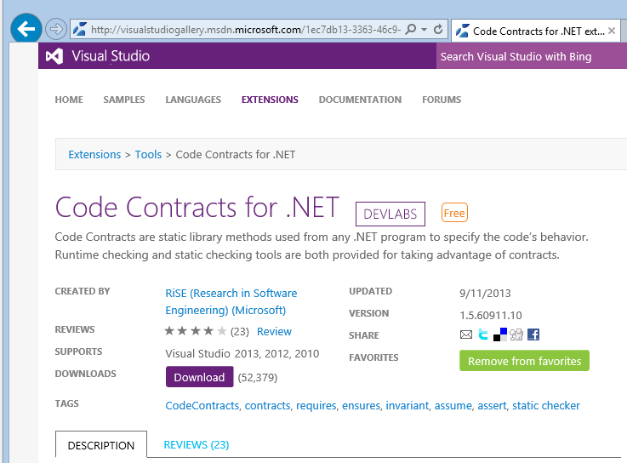

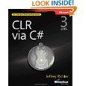
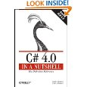
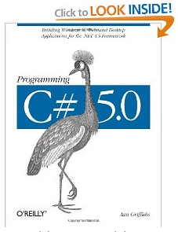
FAQ #6: “How good are the tools?”
Widely tested and used
Externally available ~4 years
>120,000 downloads
4 book chapters on CodeContracts
Many dozens of blog articles
Active forum
> 5,000 messages
Internal and external adoption
State of the art research
Publications, talks, lectures
BUILD, POPL, PLDI, OOPSLA, ECOOP, VMCAI, APLAS, SAS, SAC, FoVeOOS, VSTTE …

Slide 23
Internship

Slide 24
Which experience?
Work with a mentor, usually a researcher
Have a well-defined (hard?) problem to solve
Mixture of
Theoretical contribution
Hacking
Very likely you will interact with product groups

Slide 25
Publications…
Publish the results of your internship
See the list of publications of previous interns
Ship the code you write in production
Ex. Mehdi, Jacques-Henri, Vincent code is in CodeContracts
(and it is pretty robust too ;-)

Slide 26
How do I apply?
Use the website, or
Send an email directly the researcher you want to work with
Example:logozzo@microsoft.com

Slide 27
Questions? Ask Mehdi!!!! (I am on the other side of the Atlantic sleeping ;-) )

